Slide 1

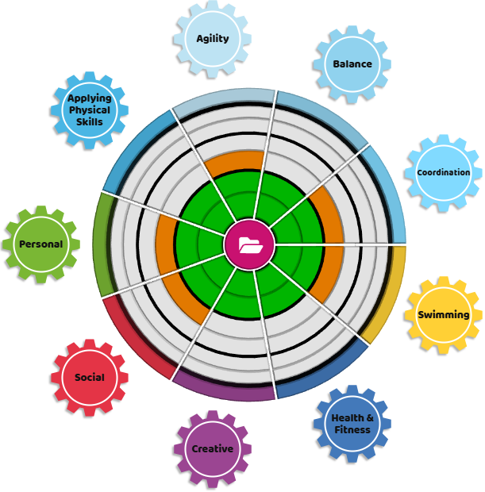
Assessment in Physical Education at St Just Primary
Formative Assessment
Ongoing Observation:
Teachers observe students during lessons, providing verbal praise and feedback on improving performance. ‘That’s great, but it would be even better if ….’
Skill Checks:
Teachers continually assess specific Fundamental Movement Skills (FMS) within each unit of work such as throwing, catching, or jumping.
Performance Assessments:
Pupils are challenged to perform a specific FMS with their performance evaluated based on predetermined criteria.
Self and Peer Assessment:
Pupils can reflect on their own performance and provide feedback to each other.
Questioning and Feedback:
Teachers ask questions to gauge student understanding of sport-specific vocabulary and provide feedback on their individual and team performance.
Summative Assessment:
End-of-Unit or Term:
Teachers conduct more formal assessments to gauge overall progress and understanding of key skills and concepts. This is recorded on the Trust’s bespoke Create Development Assessment Wheel.
Skills and Knowledge Checks:
Teachers question pupils on sport-specific rules, strategies and tactics.
Performance Assessments:
Pupils are assessed on their ability to perform a range of Fundamental Movement Skills, including swimming.
Key Areas of Focus:
Using the REAL PE curriculum, pupils are continually assessed against these six Learning Behaviours using a RAG rating system:
Personal
Social
Cognitive
Creative
Physical
Fitness
Motor Skill Development:
Assessments focus on basic movements (FMS) like running, jumping, throwing, and catching, as well as agility, balance, and coordination (ABCs).
Knowledge and Understanding:
Pupils are assessed on their knowledge of basic rules, strategies, and safety procedures.
Personal Development:
Assessments may consider factors like participation, effort, teamwork, and sportsmanship.
Healthy Lifestyle:
Assessments can also focus on students' understanding of healthy eating habits, physical activity, and the benefits of being active.
Bespoke Assessment Wheel:
Progression of FMS Skills:
Expected end of KS1
Expected end of KS2
Aspirational
Next steps:
Assessments help teachers identify areas where pupils need more support or challenge.

